Slide 1
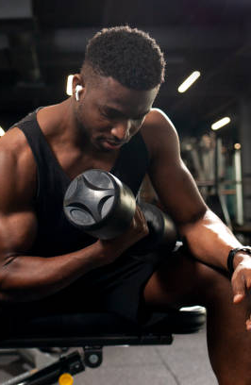
DATA MINING PROJECT PROPOSAL
PREDICTIVE MODELING OF WORKOUT ENERGY EXPENDITURE
and Caloric Burn Classification
TEAM
Solomon · Saliou Dunn · Khinememe Kyaw

Slide 2

THE PROBLEM
Calorie counts aren’t one-size-fits-all
Most fitness apps guess your calories with the same formula for everyone. But two people doing the same workout don’t burn the same amount.
When we looked at the data, four things mattered most: how long you train, how experienced you are, how often you work out, and your body fat. Knowing this helps people plan workouts that actually hit their goals without overdoing it.

Slide 3

WHAT WE’LL DO
Four questions we want to answer
REGRESSION
CLASSIFICATION
ASSOCIATION RULES
CLUSTERING
Which factors matter most, and how much?
Will a workout burn a little, a lot, or in between?
Which habits show up together in big-burn workouts?
What kinds of workouts naturally group together?
We’ll build one regression model that predicts calories burned and shows how much each factor, like session length, experience and body fat, pushes the number up or down.
We’ll sort workouts into Low (under 500 kcal), Medium (500–900) or High (over 900) and predict which group a session lands in.
We’ll look for patterns like long session + expert + low body fat → high calories. Simple “if this, then that” rules anyone can read.
Instead of picking calorie cutoffs ourselves, we’ll let the data group similar workouts and see what types show up.

Slide 4
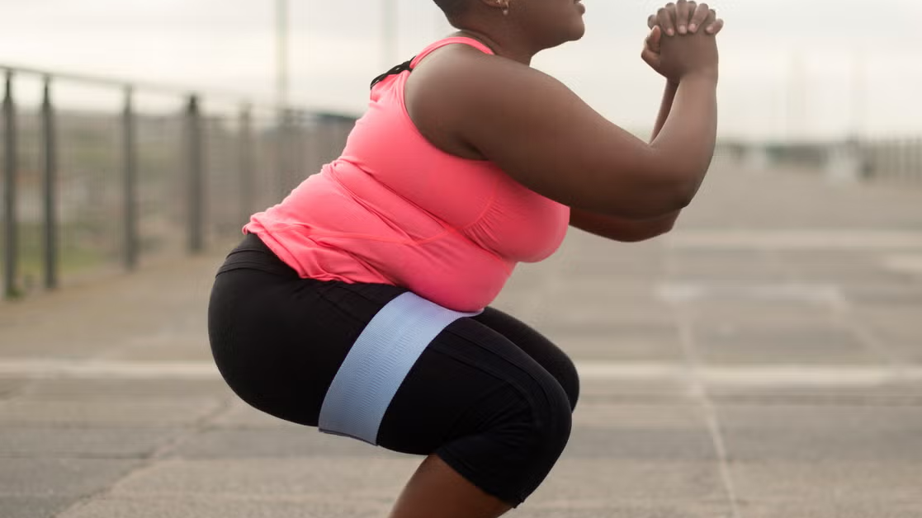
OUR DATA
Gym Members Exercise Tracking Dataset
973
Demographics
Body composition
Age, Gender
Weight, Height, BMI, Fat_Percentage
workout sessions
15
Heart rate
Workout habits
Max_BPM, Avg_BPM, Resting_BPM
Session_Duration, Calories_Burned, Workout_Type, Water_Intake, Workout_Frequency, Experience_Level
details recorded for each one
Source: Kaggle
kaggle.com/datasets/valakhorasani/
gym-members-exercise-dataset

Slide 5
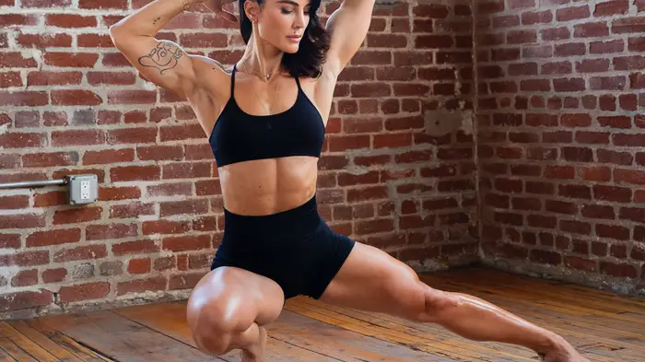
WHAT WE FOUND FIRST
What really drives calories burned
0.91
0.69
−0.60
0.58
Session duration
Experience level
Body fat %
Workout frequency
The longer you train, the more you burn
Experienced lifters burn more each session
More body fat, fewer calories burned
People who train more often burn more
Each number shows how closely a factor tracks calories burned, from −1 to 1 (Pearson r). BMI, max heart rate and resting heart rate barely mattered.

Slide 6
PRIOR WORK
What others have done
KAGGLE NOTEBOOK · MARC DUMAGUIN
WHAT WE’LL DO DIFFERENTLY
Linear Regression + Gradio User Input: Calories Burned
Predict both the exact calories (regression) and a low, medium or high level (classification).
Focus on what matters most, like experience, body fat and session duration.
Go further with pattern-finding (association rules) and grouping (clustering).
Marc used a simple linear regression on weight, height, heart rate, workout length and frequency to predict calories burned, then built a small app where you type in your own numbers.
kaggle.com/code/marcdumaguin/
line-regression-gradio-user-input-cal-burned

Slide 7

WHY THIS INTERESTS US
Real data from the way we train
Smarter than a smartwatch
Less guessing
We love this stuff
Our watches use the same formula for everyone. We want to see what really drives calories burned, so people can train at the right level and avoid overtraining or injury.
Instead of guessing, people can see which workouts and habits actually get them to their calorie goals.
We’re all gym regulars, so it’s interesting to see how modeling detailed information can show which attributes have a stronger influence on reaching a specific target pertaining to our physique goal.

Slide 8

THANK YOU
QUESTIONS?
Solomon · Saliou Dunn · Khinememe Kyaw

